Slide 1
Title: Integrating the MPU6050 IMU Sensor in Autonomous Vehicle
Subtopics: Basics, Purpose, Data, and Implementation

Slide 2
Introduction to IMU Sensors
What is an IMU?
An Inertial Measurement Unit (IMU) is a device that measures and reports a vehicle's specific force, angular rate, and sometimes magnetic field.
IMUs are widely used in applications where orientation, velocity, and position are needed, such as robotics, drones, mobile phones, and autonomous vehicles.

Slide 3
Basic Functionality of an IMU:
An IMU typically contains multiple sensors:
Accelerometer: Measures linear acceleration in 3 axes (x, y, z).
Gyroscope: Measures rotational velocity around 3 axes (roll, pitch, yaw).

Slide 4
Overview of the MPU6050 IMU Sensor
MPU6050 Specifications:
Manufactured by InvenSense.
Combines a 3-axis accelerometer and a 3-axis gyroscope in a single chip.
Data Interface: I2C, making it easy to interface with microcontrollers like Arduino and Raspberry Pi.
Range:
Accelerometer: Selectable ranges of ±2g, ±4g, ±8g, and ±16g.
Gyroscope: Selectable ranges of ±250, ±500, ±1000, and ±2000 degrees/second.
Purpose of MPU6050:
Provides information about the vehicle’s orientation and movement, which can be used for localization and navigation.

Slide 5
Data Provided by the MPU6050
Accelerometer Data:
Measures linear acceleration along the x, y, and z axes.
Used to detect changes in speed and can infer orientation (e.g., tilt) relative to gravity.
Gyroscope Data:
Measures angular velocity around the x, y, and z axes.
Helps to track the rotation of the vehicle, providing insights into changes in direction.
Sample Data Format:
Example values from the IMU might look like this:
Accelerometer: Ax = 0.5g, Ay = 0.1g, Az = 9.8g (where g is gravity)
Gyroscope: Gx = 30°/s, Gy = 0°/s, Gz = -15°/s

Slide 6
How the IMU Helps in Our Autonomous Car Project
Primary Purposes:
Orientation Tracking: Provides data to determine the car's tilt and rotation, helping with stable movement and correct alignment on the path.
Acceleration Measurement: Detects changes in the car’s speed, which can be useful for controlling the vehicle smoothly.
Assists in Localization: The IMU can work with other sensors (like LiDAR) to estimate the car’s position more accurately, especially in cases of short-term drift correction.
Why Use IMU Along with LiDAR:
LiDAR is excellent for creating maps and detecting obstacles, but it may have limitations in tracking subtle orientation changes.
The IMU compensates for short-term orientation changes, especially in low-speed situations where LiDAR data may not be precise enough for fine adjustments.

Slide 7
Integrating the MPU6050 into the Project
Hardware Setup:
Connection to Microcontroller: The MPU6050 communicates via I2C.
Wiring:
VCC to 3.3V or 5V (based on microcontroller’s voltage level).
GND to GND.
SCL and SDA to respective I2C pins on the microcontroller (e.g., A4 and A5 on Arduino).
Placement on the Vehicle: Mount the MPU6050 in a stable position near the center of the vehicle to minimize vibrations and ensure accurate readings.
Software Integration:
Arduino Code: Using an MPU6050 library (e.g., Adafruit or Jeff Rowberg’s MPU6050 library) to initialize and read data from the sensor.
ROS2 Integration:
The IMU data can be published to a ROS2 topic (e.g., /imu/data).
ROS2 nodes can then subscribe to this topic for orientation and motion data, which helps with localization and navigation.

Slide 8
Data Flow in the System
Step-by-Step Data Flow:
Data Collection: MPU6050 reads linear acceleration and angular velocity.
2. Preprocessing on Arduino: Basic filtering (if any) and formatting data.
3. Data Transmission to Raspberry Pi (RP4): Arduino sends data over I2C or serial to RP4.
4. ROS2 Node Publishes IMU Data: A ROS2 node on RP4 reads the data and publishes it to /imu/data.
5. Data Fusion and Usage:
The robot_localization package combines IMU data with other sensor data (like LiDAR) to estimate position and orientation.
Navigation and Control Nodes use this information to adjust the car’s path and maintain stability.

Slide 9
Important Concepts for Working with IMU Data:
1. Noise and Drift:
IMU sensors can be noisy and subject to drift over time, especially in low-cost sensors like the MPU6050.
Solution: Use filtering techniques such as the Complementary Filter or Kalman Filter (provided by ROS2 packages like robot_localization) to fuse IMU data with other sensors and reduce drift.
2. Sensor Calibration:
Accelerometer Calibration: Ensures that the IMU’s readings are accurate for each axis. A common method involves placing the sensor in different orientations and adjusting for gravity.
Gyroscope Calibration: Corrects for any inherent bias in the gyroscope readings to prevent drift.
3. Coordinate Frames and Transformation:
The data from the IMU needs to be correctly oriented with respect to the car’s frame of reference (base_link). ROS2 uses tf2 (transformation) to manage coordinate frames and ensure that IMU data aligns with other sensor data.

Slide 10
Implementation Challenges and Solutions
Challenge: Managing IMU Drift
Solution: Combine IMU data with other sources, like LiDAR, using robot_localization for more accurate state estimation.
Challenge: Processing IMU Data in Real-Time
Solution: Preprocess data on Arduino to reduce computational load on RP4 and only send essential information.
Challenge: Ensuring Stable Mounting
Solution: Mount the IMU near the center of mass and use damping materials if necessary to reduce vibrations.

Slide 11
Conclusion and Next Steps
Summary:
The MPU6050 provides essential orientation and acceleration data that improves localization and stability in our autonomous car project.
By integrating this data with other sensors, the car can more accurately navigate the environment.
Next Steps:
Implement the IMU data publishing node on RP4.
Test data fusion with robot_localization to verify the effectiveness of IMU in localization.
Fine-tune the IMU data usage based on initial testing and project needs.

Slide 12
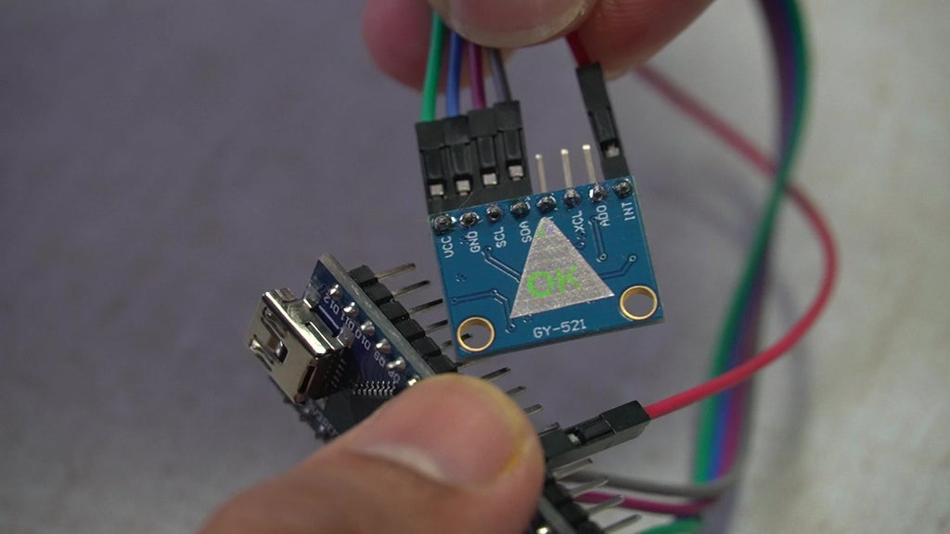
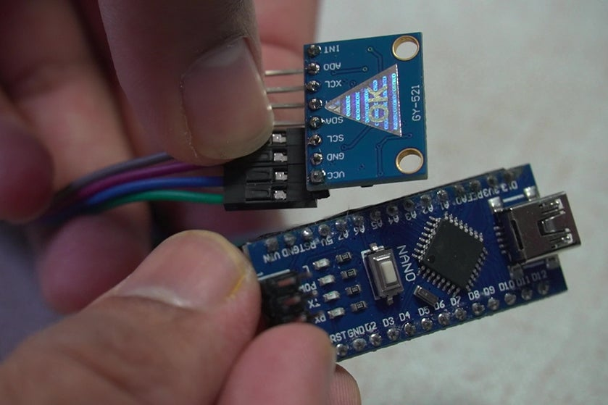
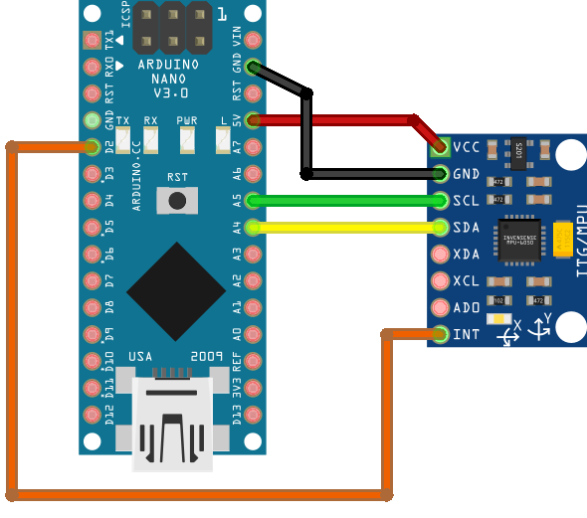

Slide 13
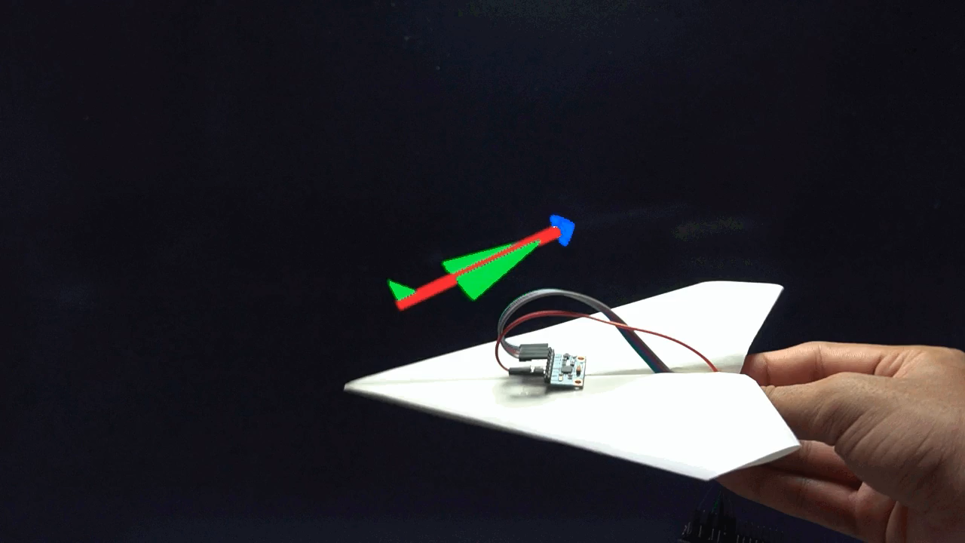

Slide 14
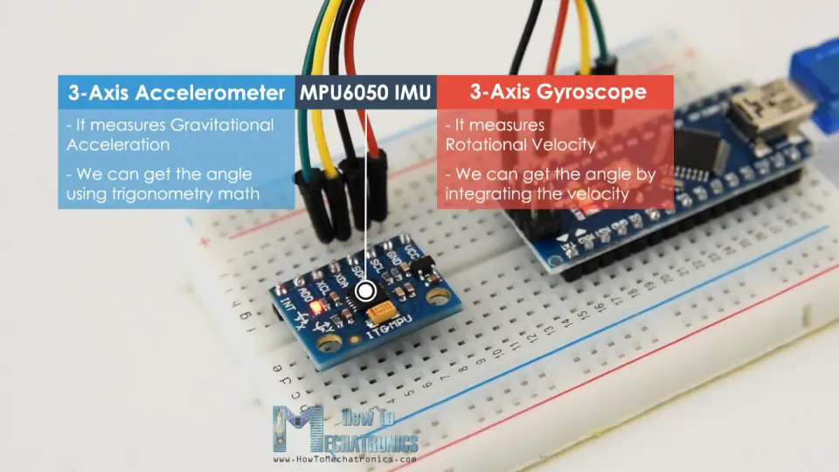

Slide 15
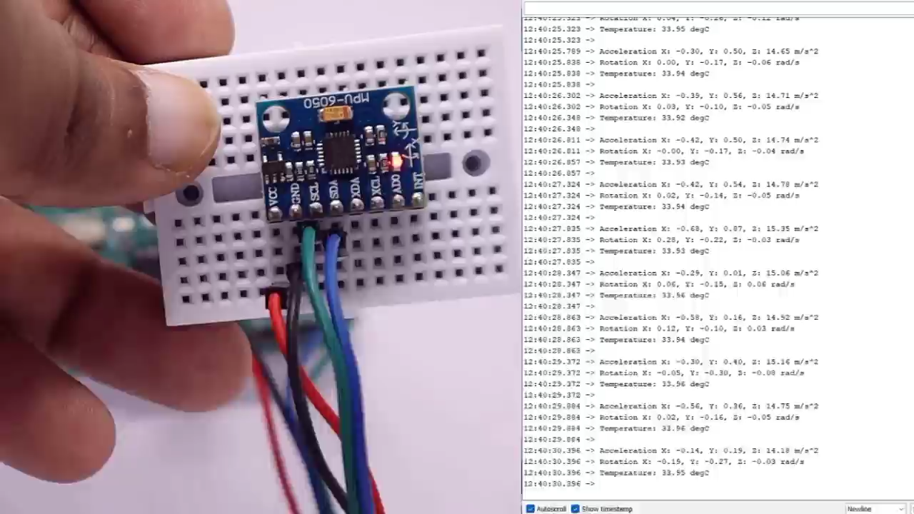

Slide 16
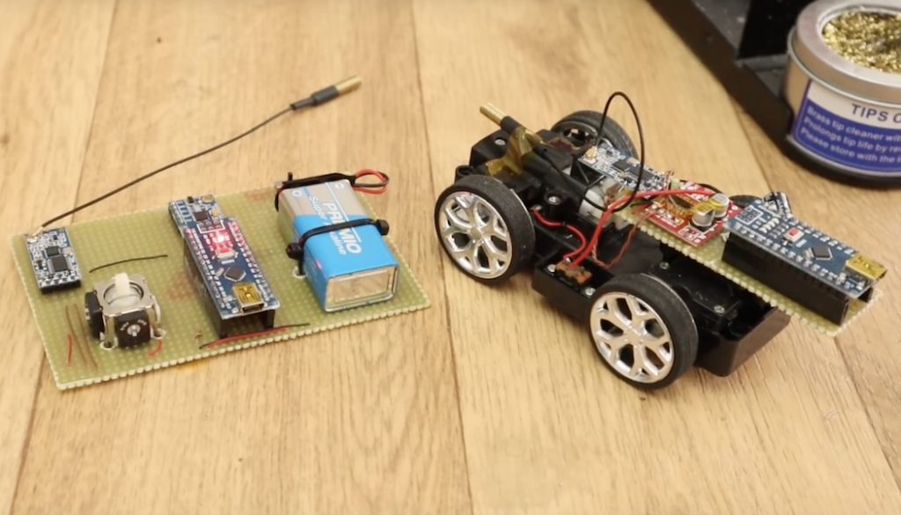
Augment RC vehicle control with an IMU-based transmitter
https://blog.arduino.cc/2018/10/02/augment-rc-vehicle-control-with-an-imu-based-transmitter/

Slide 17
Demo created (by me) for IMU sensor where fake value is published in the topic /data/imu
https://vimeo.com/1028156074

Slide 18
IMU setup in hardware
Components Needed
IMU Sensor (e.g., MPU6050)
Microcontroller (e.g., Arduino) to read data from the IMU
Main Computer (e.g., Raspberry Pi 4 running ROS2)
Connecting Wires for I2C connection
Power Supply for the Arduino (often powered through USB from the Pi)
Wiring Connections (for MPU6050)
If you’re using an MPU6050, it typically communicates over I2C. Here’s how to wire it:
VCC to 5V on the Arduino (or 3.3V if required by your IMU version).
GND to GND on the Arduino.
SCL (Serial Clock) to A5 (Arduino UNO) or designated SCL pin on other models.
SDA (Serial Data) to A4 (Arduino UNO) or designated SDA pin on other models.
This setup will allow the Arduino to communicate with the IMU over I2C.
1

Slide 19
IMU setup in hardware
Programming the Arduino to Read IMU Data
Next, program the Arduino to read data from the IMU and send it over serial to the Raspberry Pi.
Step 1: Install the MPU6050 Library
In the Arduino IDE:
Go to Sketch -> Include Library -> Manage Libraries…
Search for "MPU6050" and install a library like MPU6050 by Electronic Cats or MPU6050 by Jeff Rowberg.
Explanation of Code:
Acceleration and Gyroscope Data: Reads and prints accelerometer and gyroscope values to the serial output.
Serial Print Format: Data is output in a simple format that’s easy to parse in ROS2.
Upload this code to your Arduino.
2

Slide 20
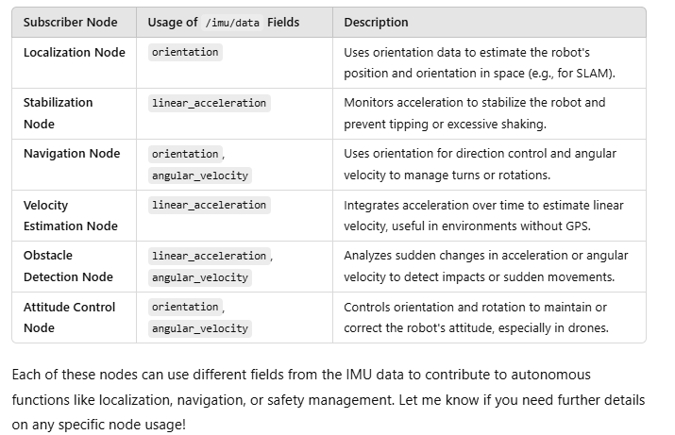
Imu_publisher
/imu/data
Imu_sub

Slide 21
References
https://howtomechatronics.com/tutorials/arduino/arduino-and-mpu6050-accelerometer-and-gyroscope-tutorial/
https://www.instructables.com/MPU-6050-Teapot-Project/
ChatGPT
https://circuitdigest.com/microcontroller-projects/interfacing-mpu6050-module-with-arduino

Slide 22
Controller

Slide 23
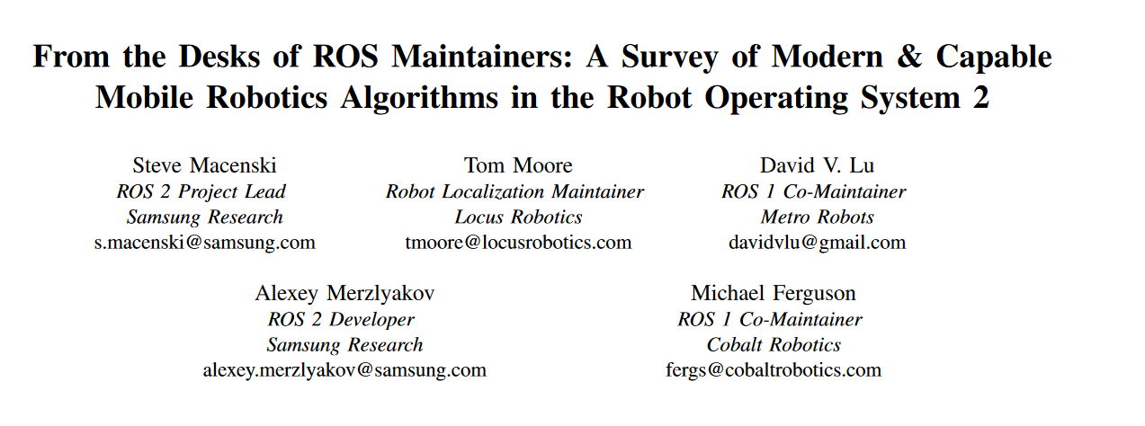
This survey includes overviews, analysis, and unique expert insight into
the algorithms and capabilities, new and old. We discuss and
compare current research products with historically robust
methods. Brief benchmarking within provides metrics for the
first time for the new key methods.
https://arxiv.org/pdf/2307.15236

Slide 24
Points of consideration

Slide 25
Refer notes:16

Slide 26
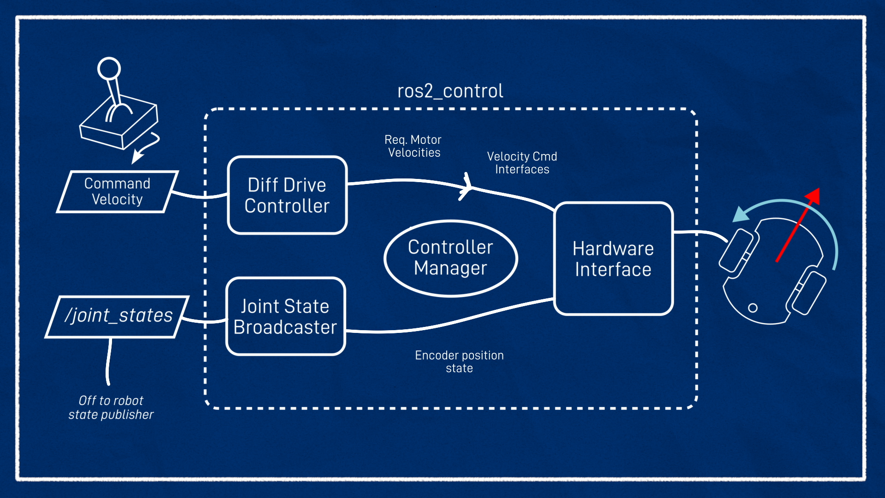
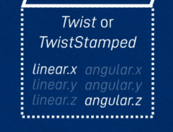
Customize for use case,
Articulated robotics tutorial
https://articulatedrobotics.xyz/tutorials/mobile-robot/applications/ros2_control-real/

Slide 27
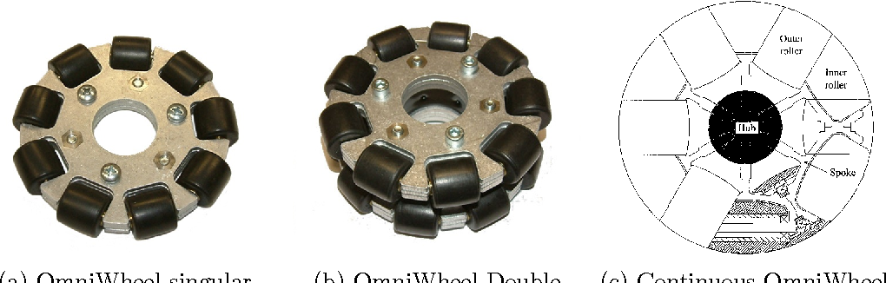
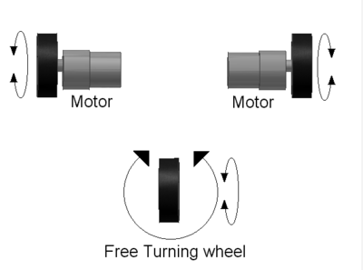
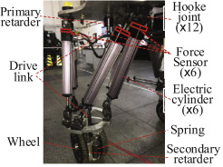
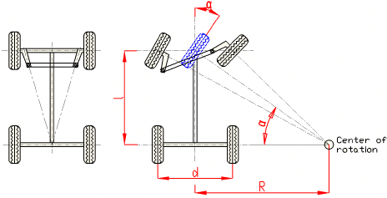
https://en.wikipedia.org/wiki/Differential_wheeled_robot
Ackermann mobile robot chassis with independent rear wheel drives - Scientific Figure on ResearchGate. Available from: https://www.researchgate.net/figure/Ackermann-steering-principle_fig2_224184352 [accessed 21 Nov 2024]
Notes:
https://www.sciencedirect.com/science/article/pii/S0957415820300684
Here’s a quick overview of the supported platform types:
Differential:
Vehicles with two independently driven wheels (e.g., robots like TurtleBot). Steering is achieved by varying wheel speeds.
Omnidirectional:
Vehicles with specialized wheels (e.g., Mecanum or Omni-wheels) that allow movement in any direction without changing orientation.
Ackermann:
Vehicles with car-like steering geometry, where front wheels turn at different angles, commonly used in autonomous cars.
Legged:
Robots with legs (e.g., quadrupeds like Spot or bipedal robots), designed for uneven terrains and complex mobility.

Slide 28
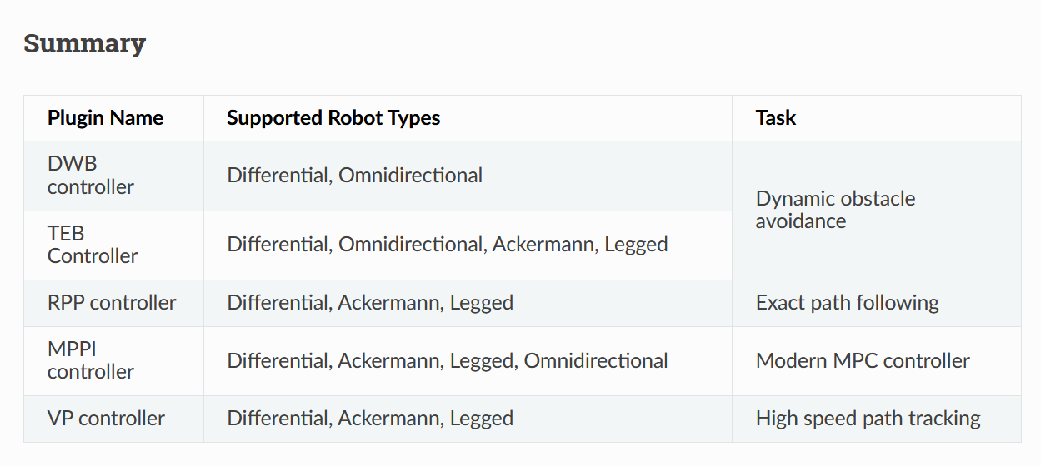
Differential types of control mechanism based on the vehicle driving system
https://docs.nav2.org/setup_guides/algorithm/select_algorithm.html#select-algorithm

Slide 29
From the construct
(Maybe) for differential drive [turtlebot3], aim is to provide workflow schema
Implementation on Ackermann based drive in gazebo
Demo of controllers:

Slide 30
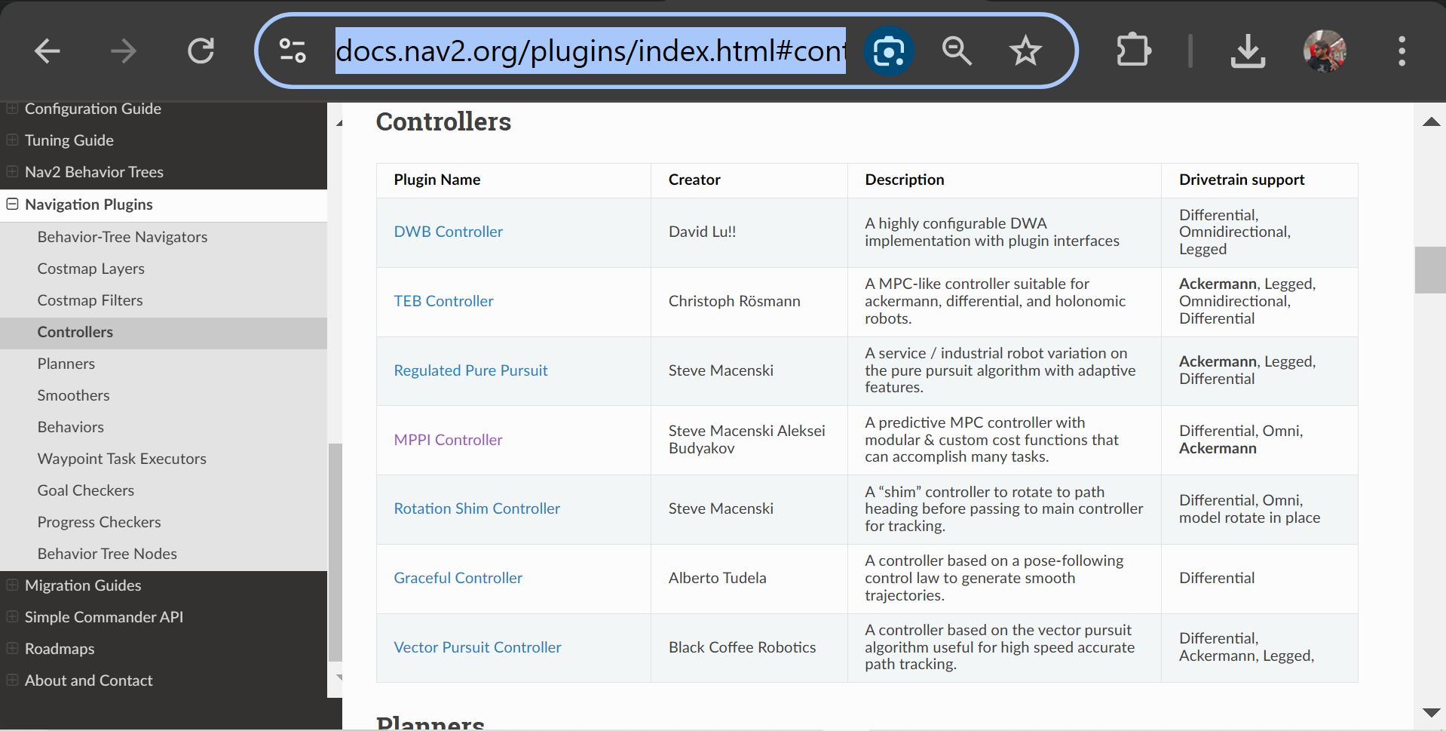
https://docs.nav2.org/plugins/index.html#controllers

Slide 31
Ros2_control

Slide 32
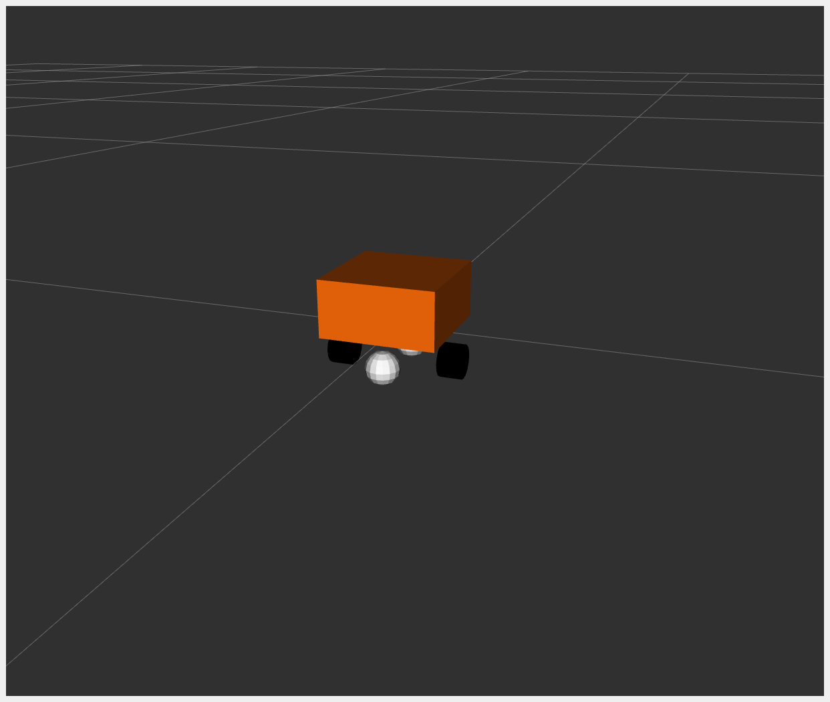
https://control.ros.org/master/doc/ros2_control_demos/example_2/doc/userdoc.html
Diffbot

Slide 33
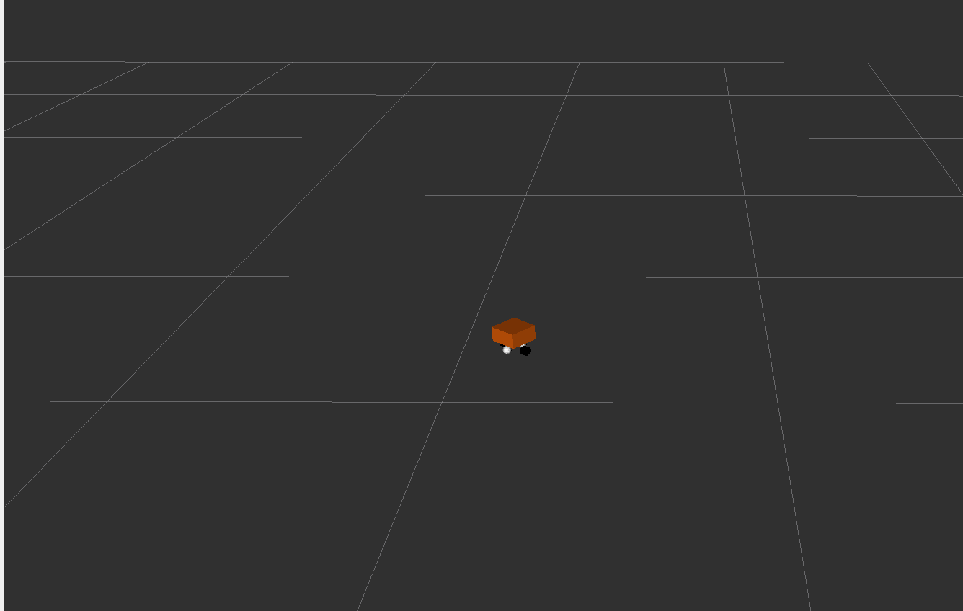
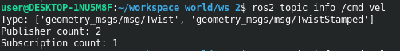
Changing parameters
diffbot_controllers.yaml file and adjust parameters like wheel_radius, wheel_separation, or velocity limits.
diff_drive_controller:
type: diff_drive_controller/DiffDriveController
parameters:
wheel_radius: 0.2 # Change the wheel size
wheel_separation: 0.6 # Increase the distance between wheels
linear.x.max_velocity: 1.5 # Modify maximum speed
angular.z.max_velocity: 0.8
Right
wrong
$ ros2 topic pub --rate 10 /cmd_vel geometry_msgs/msg/TwistStamped "twist: linear: x: 0.7 y: 0.0 z: 0.0 angular: x: 0.0 y: 0.0 z: 1.0
$ ros2 topic pub /cmd_vel geometry_msgs/msg/Twist "linear: x: 1.0 y: 0.0 z: 0.0angular: x: 0.0 y: 0.0 z: 0.5

Slide 34
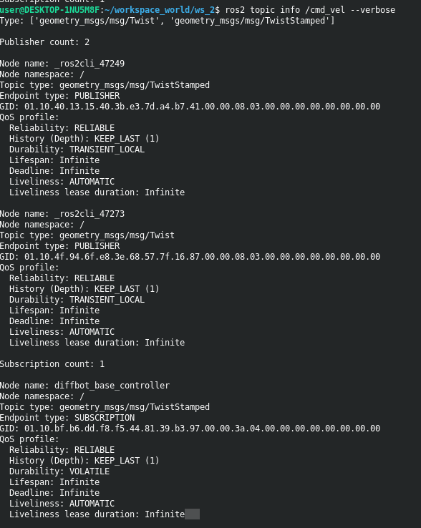
Troubleshoot: check subscriber subscribes to which “type” of topic

Slide 35
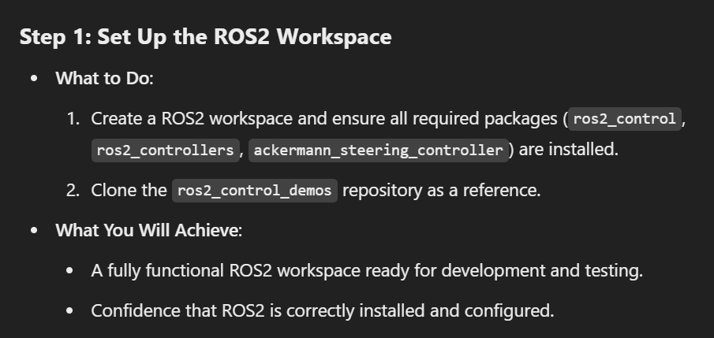
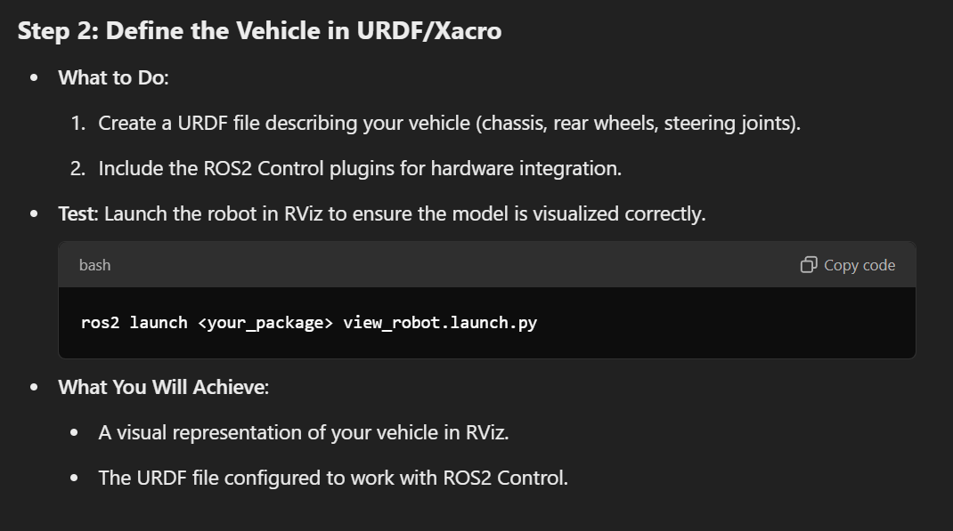
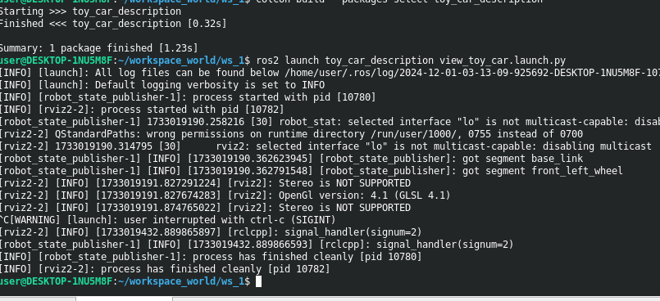

Slide 36
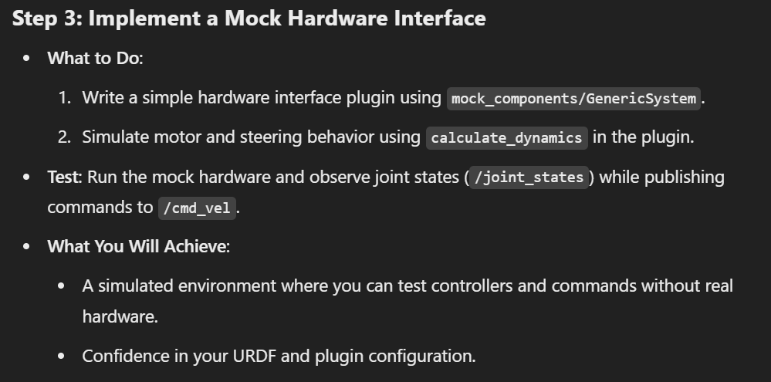

Slide 37
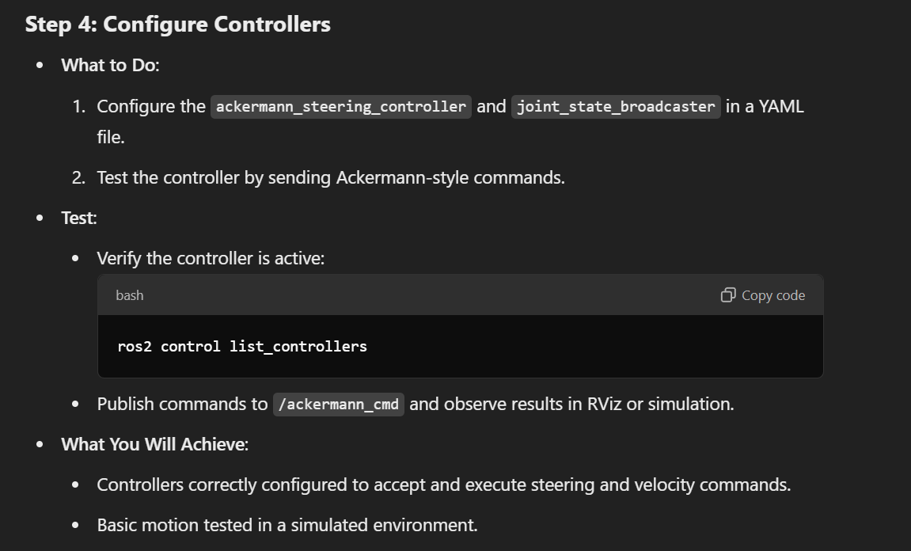

Slide 38
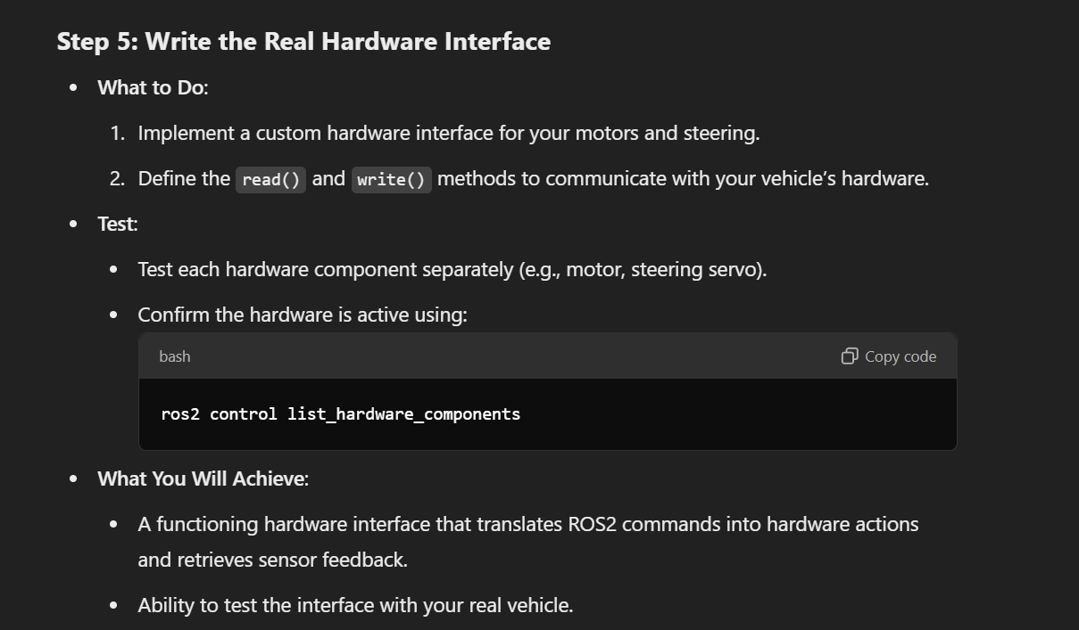

Slide 39
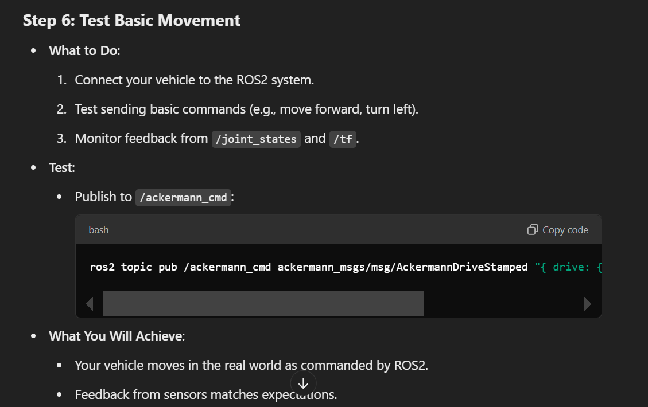

Slide 40
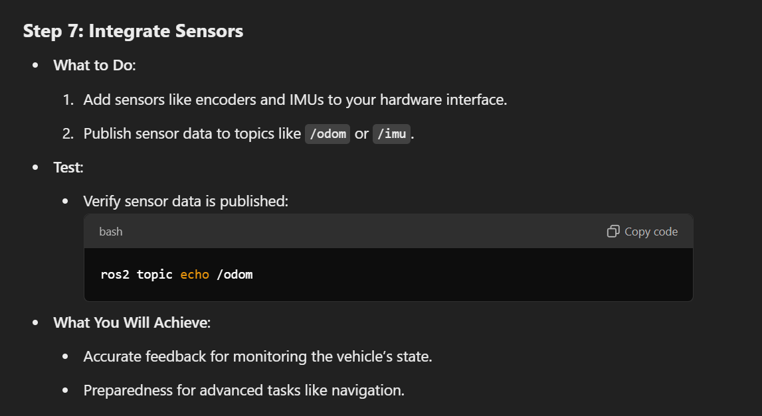

Slide 41
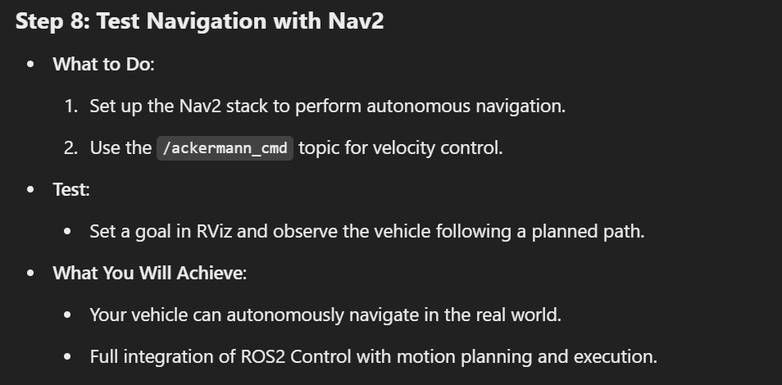

Slide 42
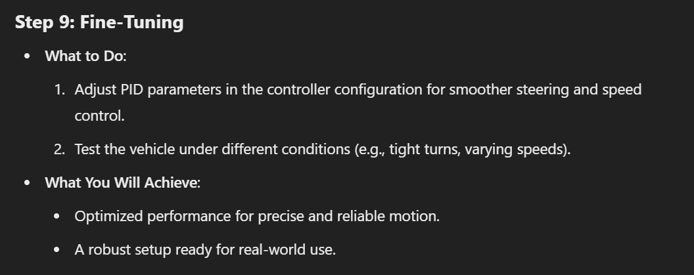

Slide 43
Understanding for further work- Hardware Setup
Hardware Setup
Motors and Steering:
Rear motors controlled via PWM signals.
Steering system controlled by a servo motor.
Feedback:
No feedback initially for the steering.
Plan to use a color sensor later to measure the turn taken by the vehicle.
Sensors:
Currently available: LIDAR and IMU.
Planned additions:
Camera.
Ultrasonic sensors.
Color sensor for steering feedback.
Encoders for wheel feedback.
Control Hardware:
Using ZK-BM1 motor driver:
One output controls two DC motors.
Another output controls the servo motor.
Communication:
Raspberry Pi communicates with Arduino via USB.
Arduino communicates with the motor driver through PWM signals.

Slide 44
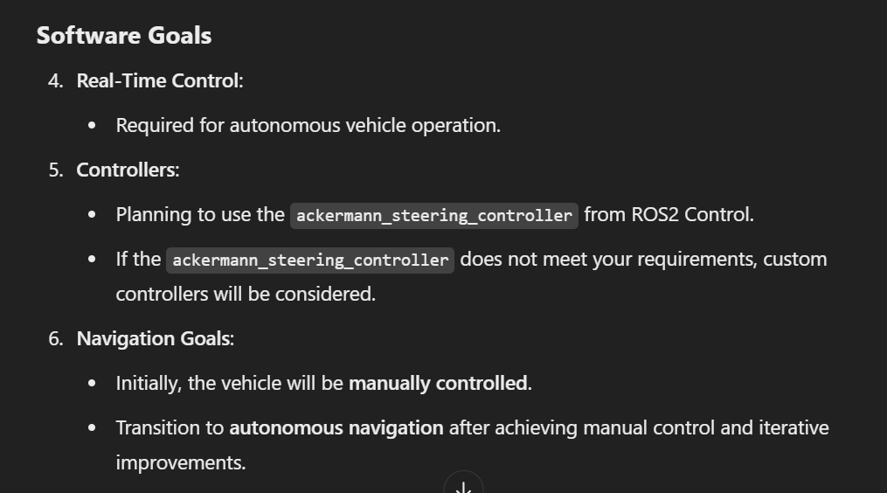
Understanding for further work- Software Setup

Slide 45
Understanding for further work- Development and Testing
Development and Testing
Simulation vs. Real Hardware:
Simulation:
Access to Gazebo for virtual testing.
Real Hardware:
Plan to test on real hardware as soon as possible.
Incremental Goals:
First milestone: Achieve basic motion.
SLAM: Already achieved using IMU, LIDAR, and mocked odometry.
Subsequent milestones: Sensor integration, navigation, and obstacle avoidance

Slide 46
Understanding for further work- Integration and Deployment
Hardware Interface Plugin:
No existing code or libraries for interfacing with hardware.
Starting from scratch:
Initial focus on a mock hardware interface to simulate commands before working on real hardware.
ROS2 Version and Environment:
ROS2 Humble.
No significant computational constraints on the Raspberry Pi.

Slide 47
Further, if..
Optional Exploration
Advanced Features:
Interested in:
Visual odometry or SLAM for localization.
Obstacle avoidance or dynamic path planning.
Not interested in:
Multi-robot coordination or communication.

Slide 48
1. Additional Information Required
To fully define your URDF/Xacro, I need the following:
Chassis Dimensions:
Length, width, and height of the chassis.
Wheel Mounting:
Is the axle of the wheel centered or offset vertically on the chassis?
Weight Distribution (Optional):
Approximate weight or center of gravity if available (can be added later for physics simulation in Gazebo).
Steering Details:
Is the steering mechanism Ackermann-based with a single-point turn axis, or does it have any unique features?
Do you want to model only the front wheels turning or simulate virtual rear-wheel steering?
2. What You’ve Already Provided
Wheelbase: 55.8 cm
Track Width: 40.8 cm
Wheel Diameter: 20 cm
Steering Offset: 12 cm from the front wheel axis

Slide 49
Key Components of a Hardware Interface
Command Interfaces:
Define what type of commands the hardware can accept (e.g., set position, velocity, or effort).
Examples:
position for a servo motor to set its angle.
velocity for a DC motor to set its speed.
effort for force/torque-based control.
State Interfaces:
Define what states the hardware reports back (e.g., current position, velocity, or effort).
These are read by the read() method in the hardware interface plugin.
Claimed Interfaces:
A controller claims one or more command interfaces to manage specific hardware (e.g., a joint).

Slide 50
ROS Developers Open Class n.186: Understand Ackermann
ROS Developers Open Class n.196: How to create Web Dashboards for ROS 2

Slide 51
https://youtu.be/bQgAIV3eHbg?si=A3iqi5qmgtID3G__
https://youtu.be/LvBjVmZxxDA?si=XPYen7uNuu0KzYwN
https://youtu.be/YSlRPh-N0Fs?si=48WRin4L3DRD3iFt
https://youtu.be/RrFcKgJUK54?si=P6bpAIUSQgPZbJFv
https://youtu.be/xBhYHOSxMOk?si=hYWWMXaDafRX4sKn
https://youtu.be/3RPaWrOGYPU?si=XJftufjk2KPCL87T
https://youtu.be/vzxGgf9Jn3c?si=_mjBgf0v9Z9ISZq0
https://youtu.be/vzxGgf9Jn3c?si=_mjBgf0v9Z9ISZq0
https://youtu.be/9AsDmPJWcnQ?si=eO0iY6R3SN7i3wmP

